Slide 1

Exploratory Data Analysis
G2M Case Study
3/21/2023

Slide 2

Agenda
Executive Summary
Problem Statement
Approach
EDA
EDA Summary
Recommendations

Slide 3
Executive Summary
XYZ is a private firm in United States and the company is planning to make investments as per their Go-to-Market(G2M) strategy.
Due to the growth in cab industry, the company wishes to invest in the Cab industry but wants to understand market before making investment.
This presentation gives a clear understanding of the best Cab service/organization in the market and can guide the XYZ firm in making better decision.

Slide 4
Problem Statement
XYZ firm wants to invest in the Cab industry, but it has no knowledge of the market regarding which cab company to invest in so that it could gain profits and increase the customer base. The firm needs guidance based on the real/practical data. So, the aim of this presentation is to help the firm in making a better investment.

Slide 5
Approach
Collecting the data related, using the files Cab data, Transactions, Customers and City.
Identification and understanding of the data.
Performing pre-processing steps like Data cleaning and then performing analysis.
Performing Exploratory data analysis and providing insights through various visualizations.
Providing recommendations based on those business focused insights.

Slide 6
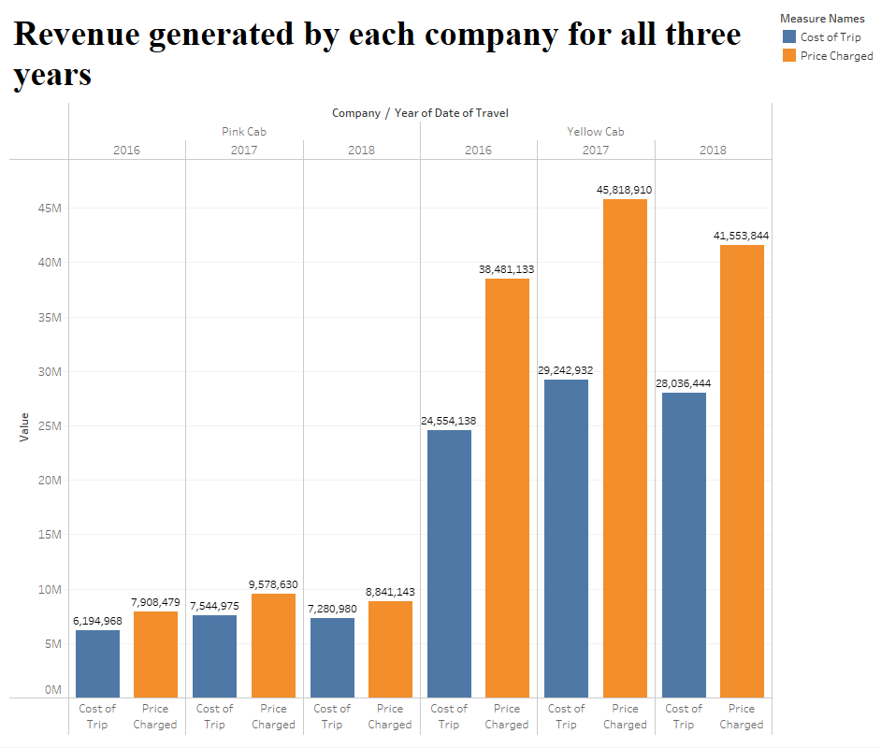
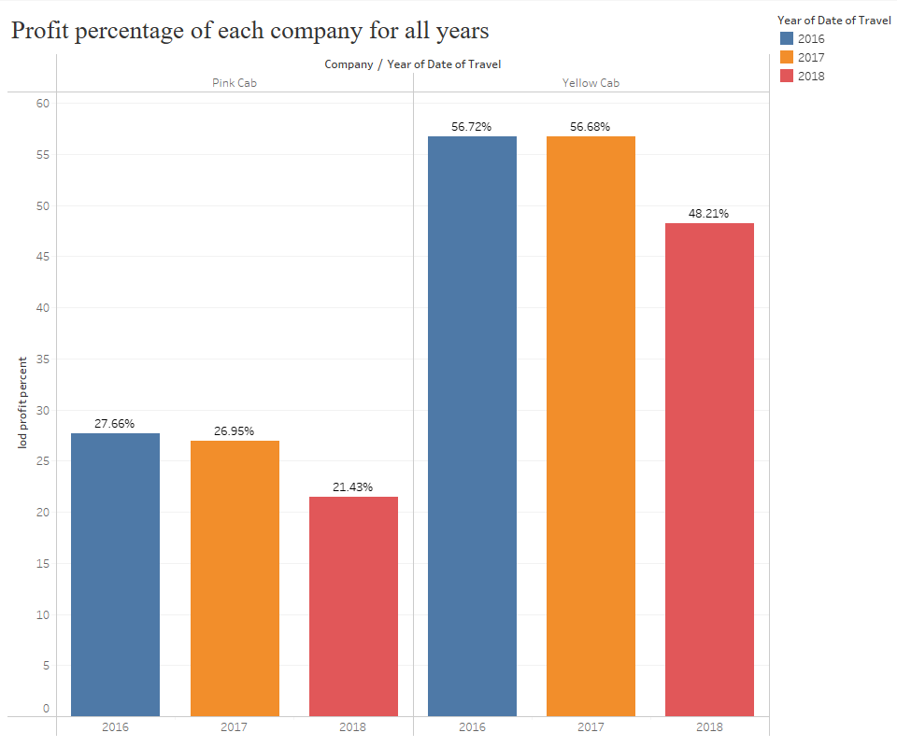
Revenue and Profit Analysis

Slide 7
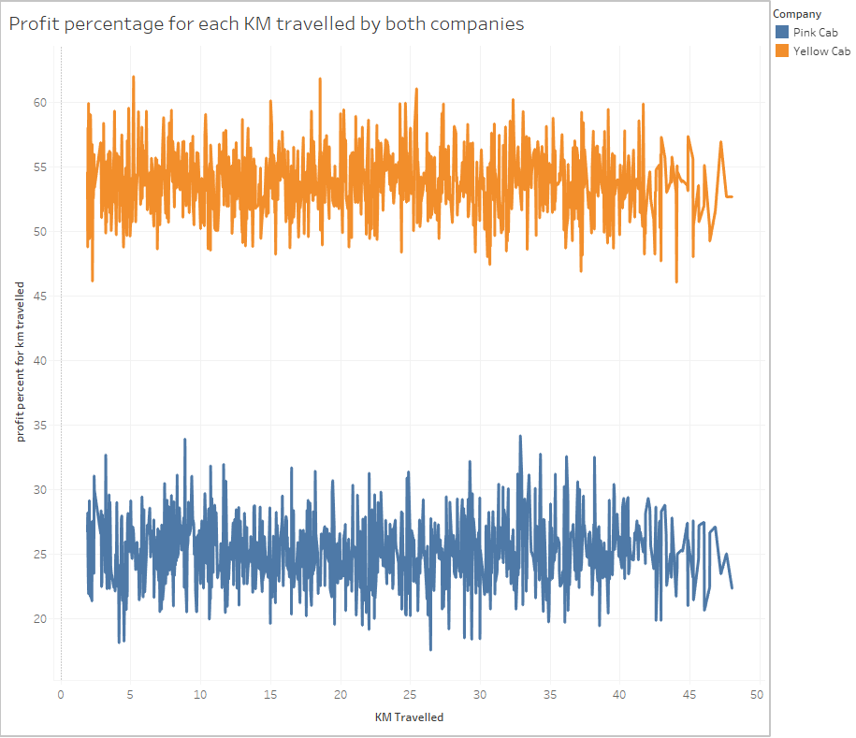
Profit Analysis for KM travelled
The profit for either cab is not varying for KM Travelled hence, the profit is not dependent on KM travelled.

Slide 8
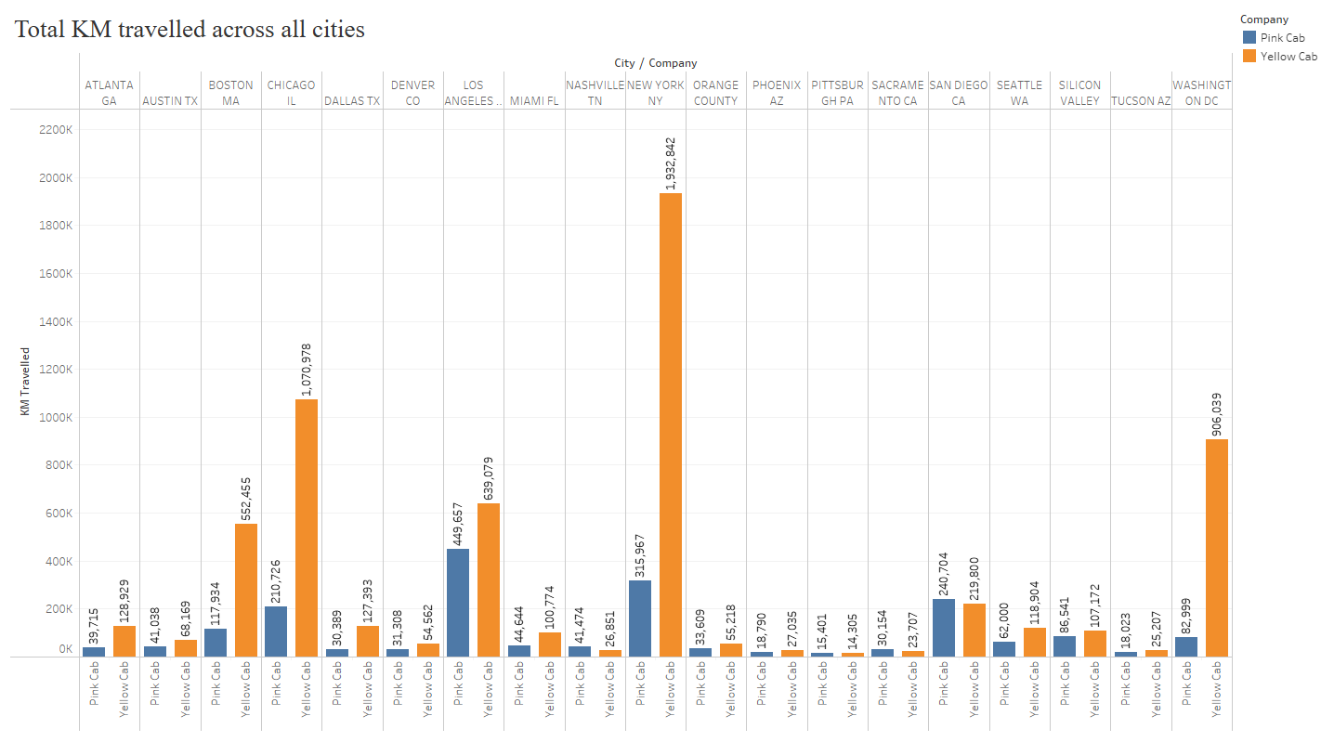
The distribution of total KM’s travelled for both companies across all cities
Yellow Cab has covered more Km’s than Pink Cab and the difference is predominant in New York which is also the highest Km’s travelled city and Pink Cab has covered more Km’s in Los Angeles when compared to other cities

Slide 9
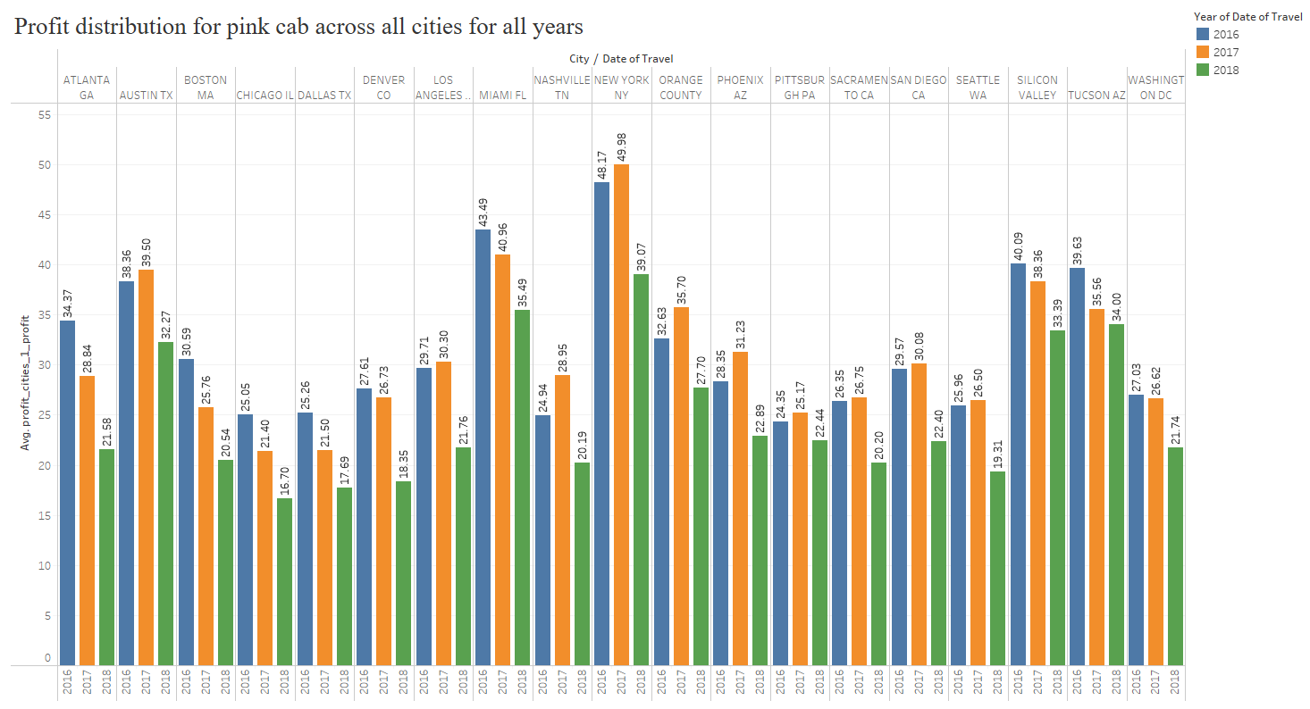
Profit percentage Analysis for Pink cab across all cities
Major Profit generating cities for Pink Cab are New York, Miami.

Slide 10
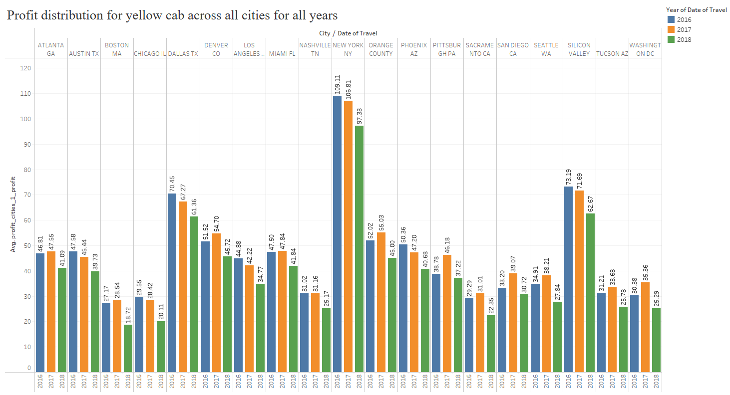
Profit percentage Analysis for yellow cab across all cities
Major Profit generating cities for Yellow Cab are New York, Silicon Valley, Dallas

Slide 11
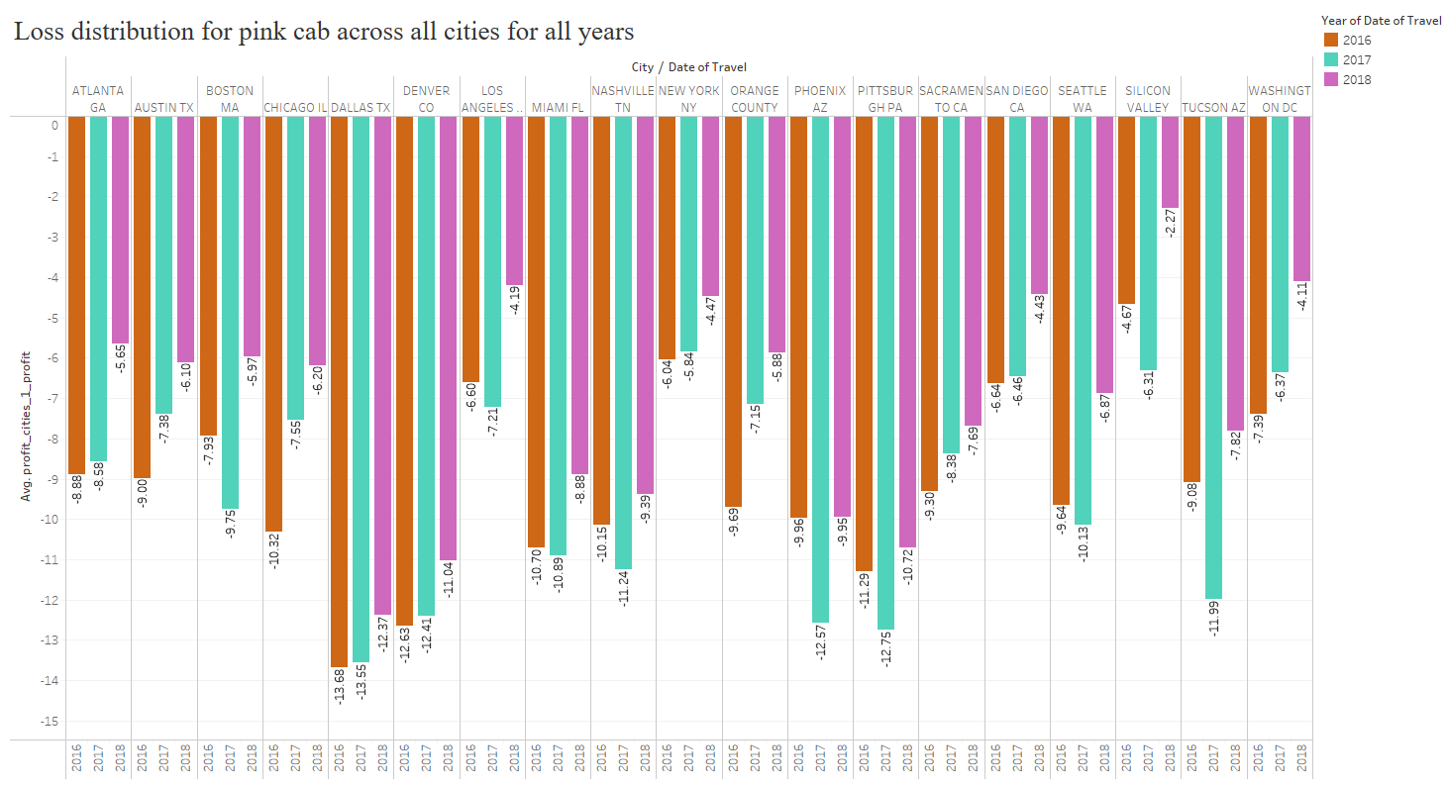
Loss percentage Analysis for Pink cab across all cities
Major Loss contributing cities for Pink Cab are Dallas, Denver, Phoenix, Pittsburgh, Tucson

Slide 12
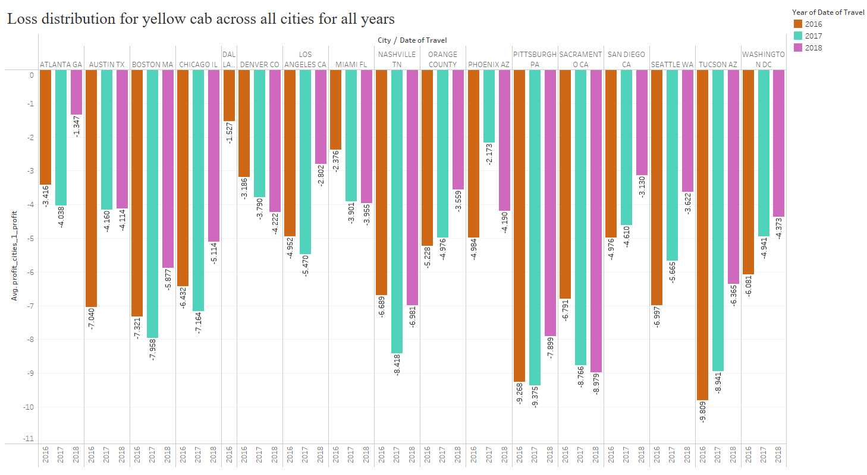
Loss percentage Analysis for Yellow cab across all cities
Major Loss contributing cities for Yellow Cab are Tucson, Pittsburgh, Sacramento.

Slide 13
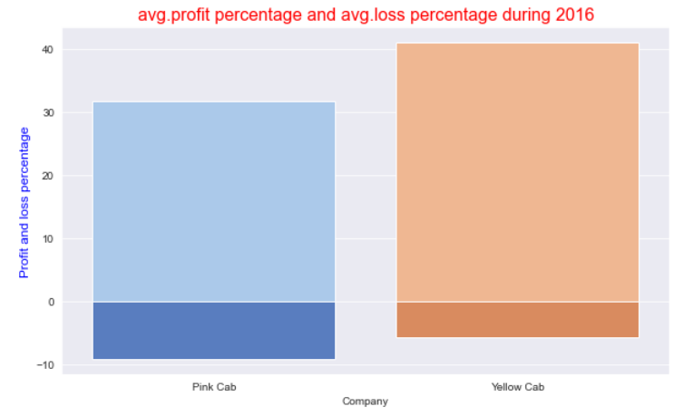
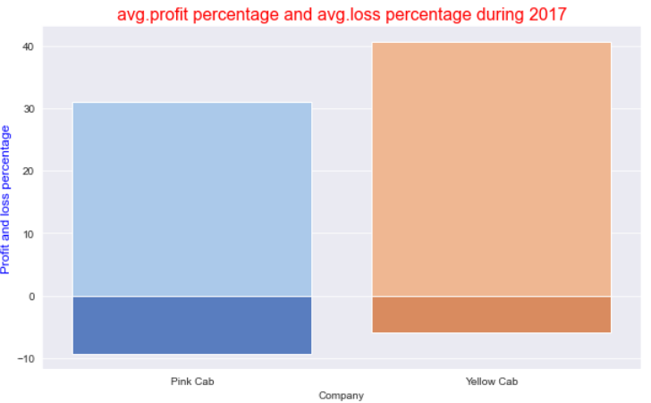
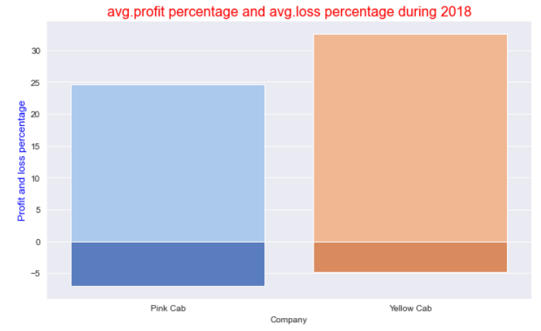
Profit and Loss percentage distribution of both companies for all years

Slide 14
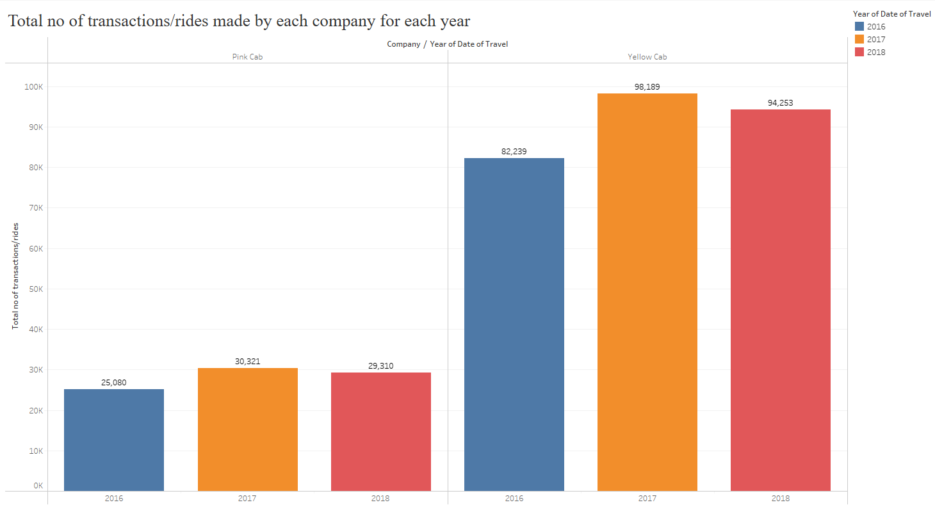
Total Rides made by each company for each year

Slide 15
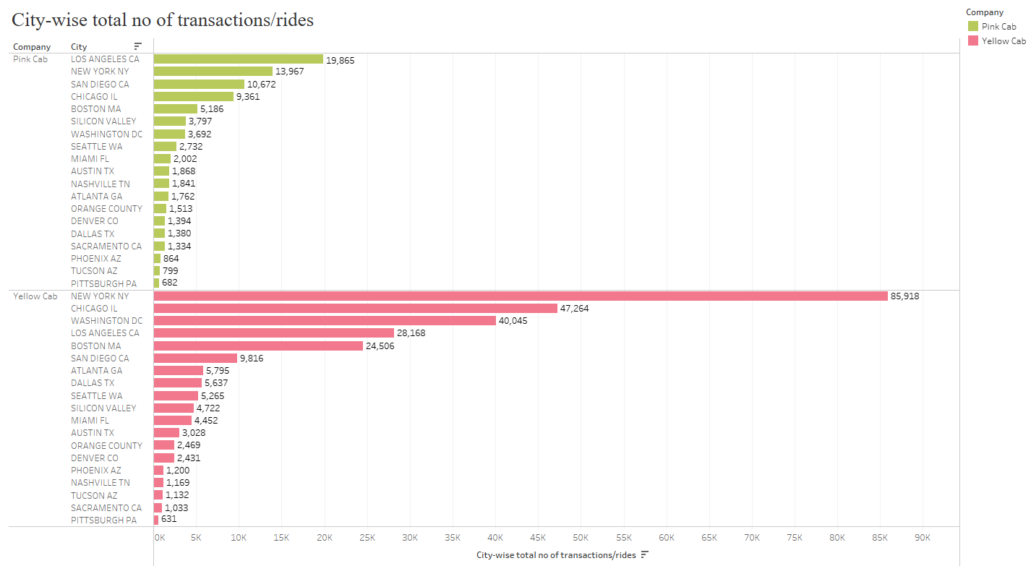
City-wise Total Rides made by each company

Slide 16
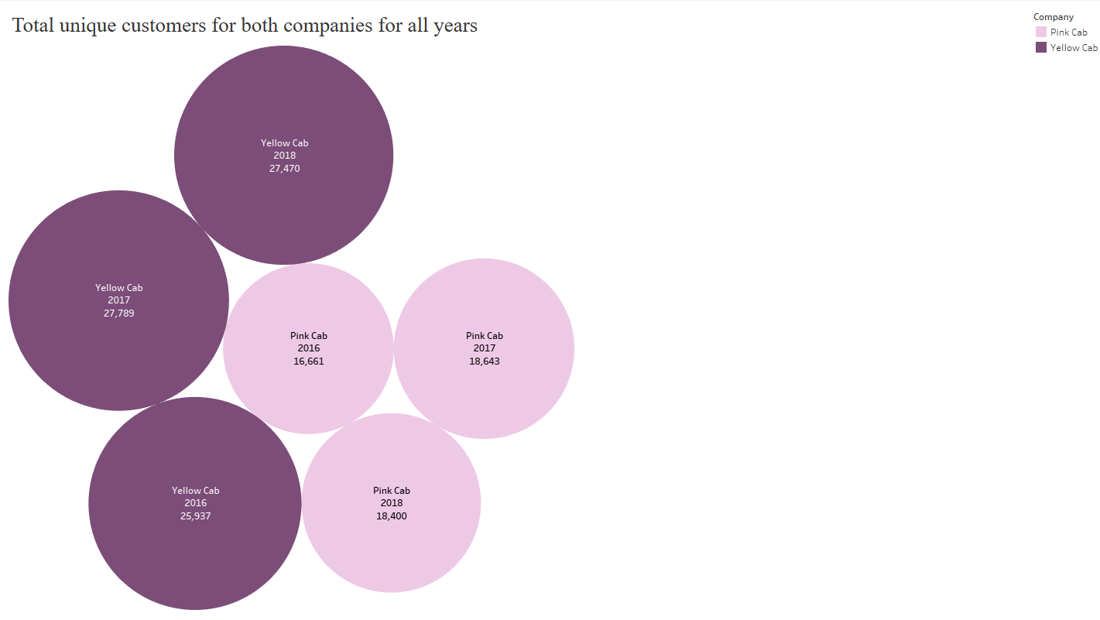
Customer base for both companies for all years
The customer base for Yellow cab is predominantly higher when compared to the Pink cab for all the years.

Slide 17
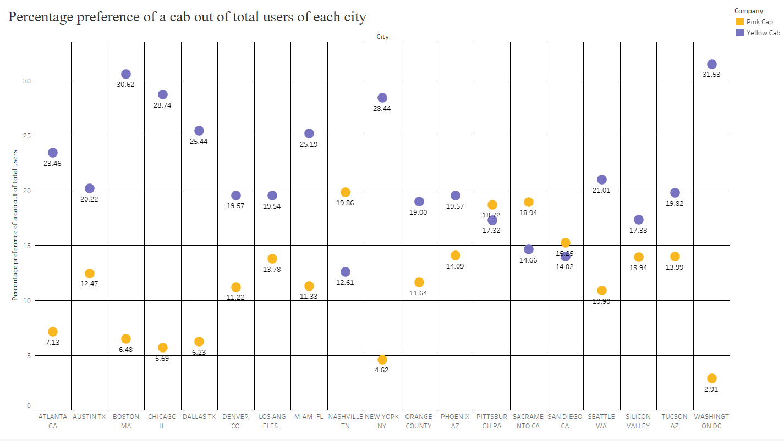
Cab Preference of people out of total users of each city
People of most of the cities preferred yellow cab over pink cab except for cities like Nashville, Pittsburgh, Sacramento, San Diego

Slide 18
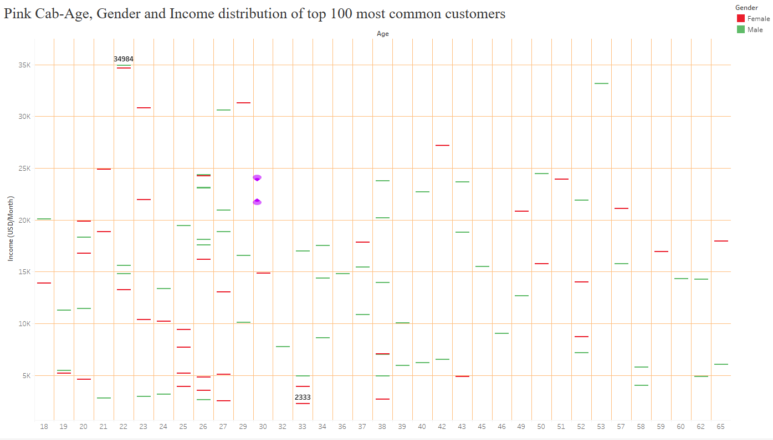
Age, Gender and Income distribution of Pink Cab customers
Most instances appear for the age between 18-27 so, Pink Cab has customers between 18-27 age whose income in USD/Month ranges from 2k till 35k and with almost equal distribution of male and female population

Slide 19
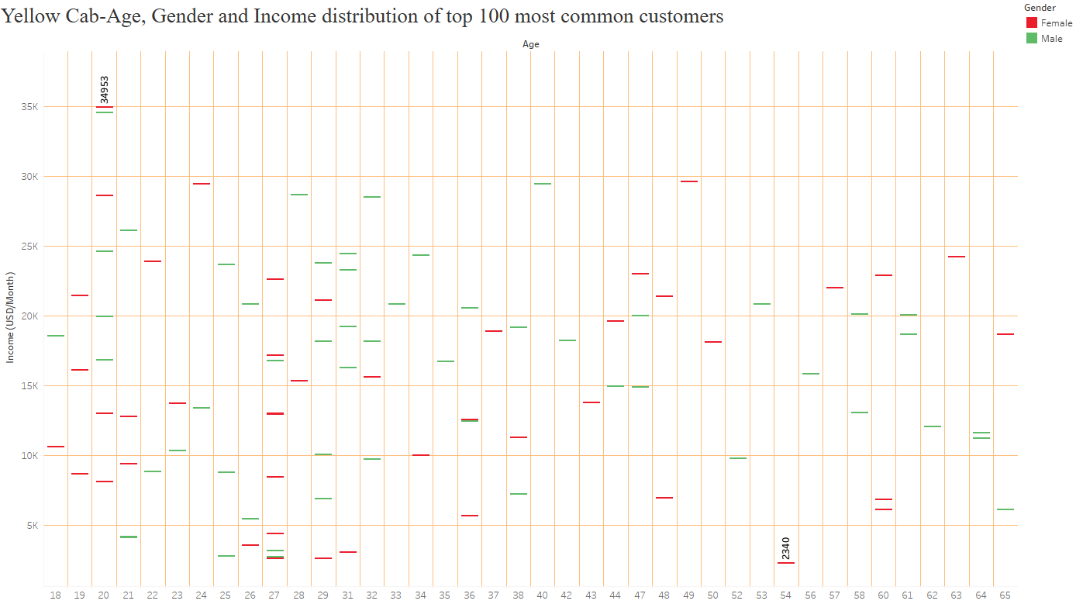
Age, Gender and Income distribution of Yellow Cab customers
Most instances appear for the age between 18-32 so, Yellow Cab has customers between 18-32 age whose income in USD/Month ranges from 2k till 35k and with almost equal distribution of male and female population

Slide 20
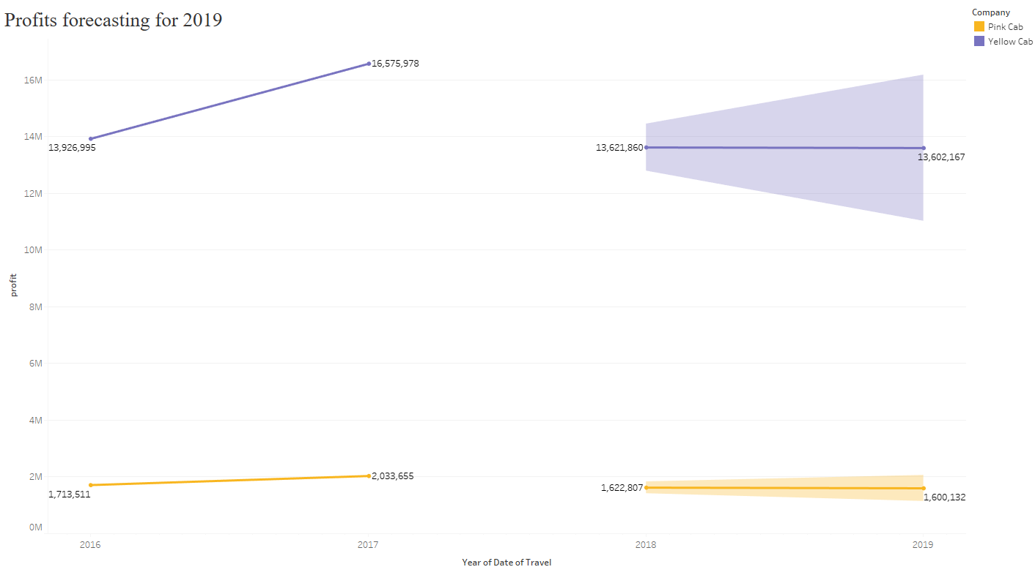
Profit percentage forecast of both companies for the year 2019

Slide 21
EDA Summary
Revenue and Profit Analysis: The revenue and profit are higher for Yellow cab than Pink cab. Also, the loss percentage distribution for Yellow cab is less when compared to Pink cab.
Yellow Cab has contributed to more no of rides when compared to Pink cab for all years across most of the cities like New York, Chicago and Washington D.C. It has also covered more KMs for the total rides than Pink Cab and the distance travelled for each ride is not affecting the profit margin for both companies.
Major Profit generating cities for Pink Cab are New York, Miami and for Yellow cab they are New York, Silicon Valley, Dallas. Loss contributing cities for Pink cab are Dallas, Denver, Phoenix, Pittsburgh, Tucson and for Yellow cab they are Tucson, Pittsburgh, Sacramento.
Customer base is also more for Yellow cab than Pink cab given any year.
Most of the users across all cities preferred Yellow cab rather than Pink cab except for cities, Nashville, Pittsburgh, Sacramento, San Diego.
Both companies have more younger customers between the age 18-27 and 18-32 respectively whose income in USD per month range between 2k-35k and have equal gender distribution.
The forecasted profit percentage for both companies for 2019 suggest a slighter loss however, that loss percentage is much smaller for Yellow cab, and it also has wider scope for profits (with 95% confidence interval)

Slide 22
Recommendations
Based on the EDA with the historical data and the profit forecast, it is highly recommended to invest in the Yellow Cab company.

Slide 23
Thank You

